Slide 1
Cross site scripting:
VULNWEB: http://testasp.vulnweb.com
Website http://testasp.vulnweb.com /
Cross-Site Scripting (XSS) attacks are a type of injection, in which malicious scripts are injected into otherwise benign and trusted websites. XSS attacks occur when an attacker uses a web application to send malicious code, generally in the form of a browser side script, to a different end user
Types of XSS:
#1) Reflected XSS – This attack occurs, when a malicious script is not being saved on the web server but reflected in the website’s results.
#2) Stored XSS – This attack occurs when a malicious script is being saved on the web server permanently.
#3) DOM – This occurs, when the DOM environment is being changed, but the code remains the same.
This happens because When the website or application stores user input in a database or a file to display it later, like a field in a profile or a comment in a forum, resulting attack.

Slide 2
Steps to Reproduce:
To reproduce this, an attacker has to:
Prepare a javascript to payload that it wants the victim to execute. In this case , for proof of Concept purposes,our javascript code will prompt an alert.
Code: <script>alert(1)</script>
Inject this javascript code properly into the vulnerable parameter, creating thus a alert1 will inject the payload.

Slide 3
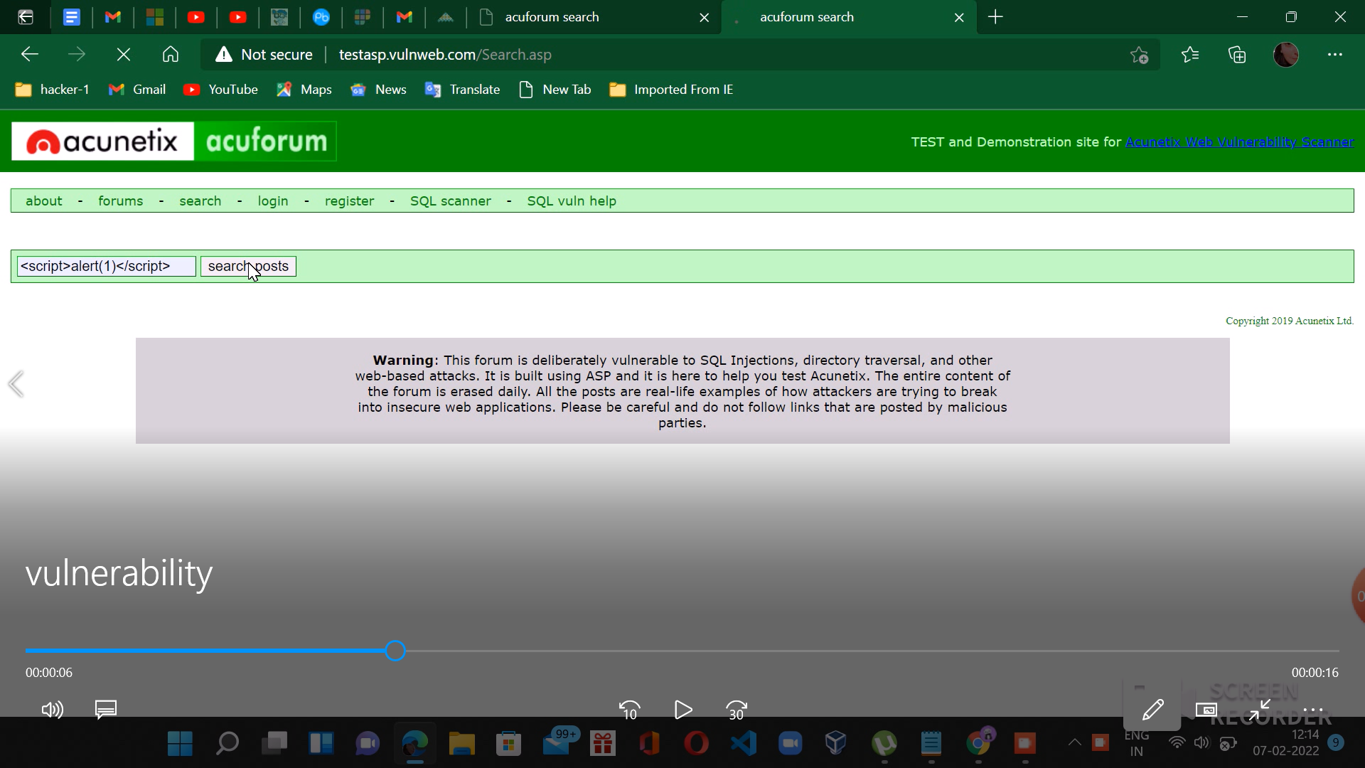
Image demonstration:
screenshots:

Slide 4
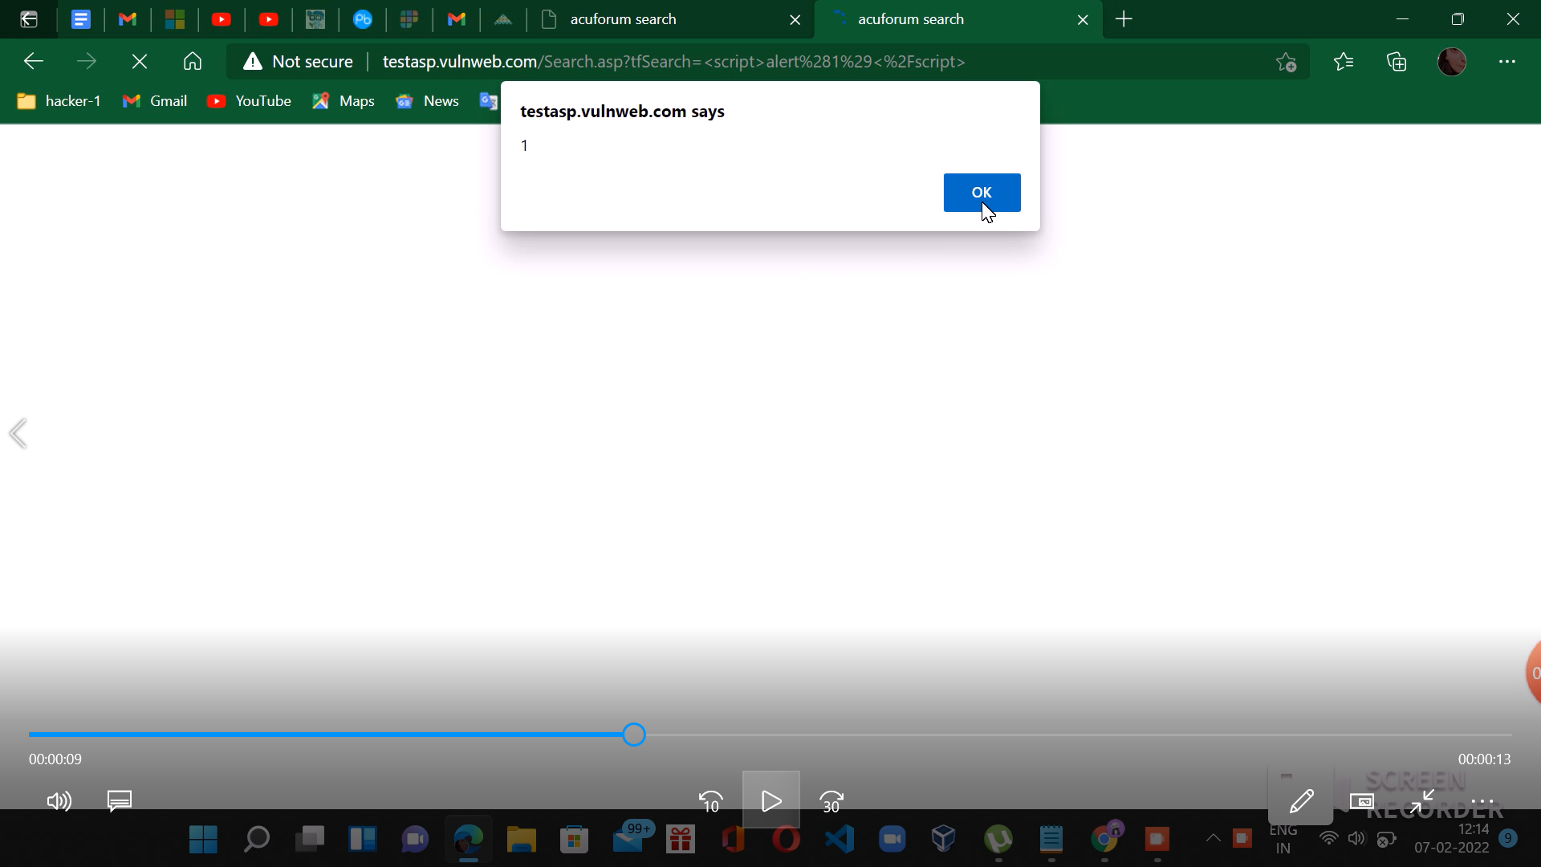
alert1:

Slide 5
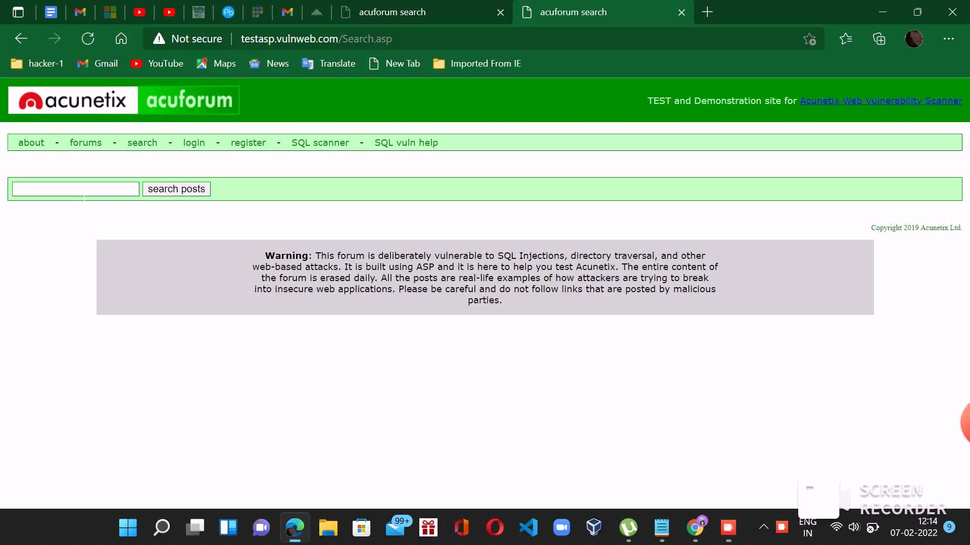
Video demonstration:

Slide 6
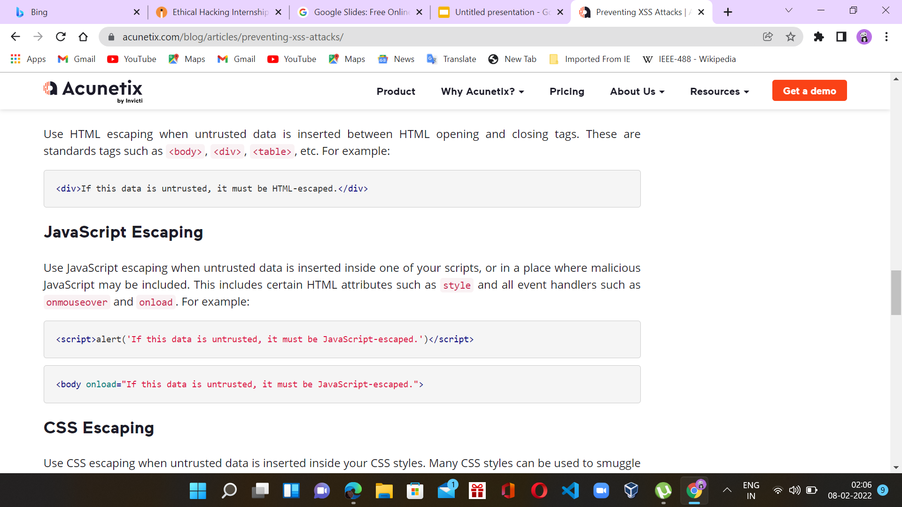
How to fix this :

Slide 7
Impact:
Account Hijacking Attackers often steal session cookies in the browser to hijack legitimate user accounts. This allows attackers to take over the victim's session and access any functionality or sensitive information on their behalf
.Credential Theft One of the most common XSS attack vectors is to use HTML and JavaScript in order to steal user credentials. Attackers can clone the login page of the web application and then use cross-site scripting vulnerabilities to serve it to the victims.
When a victim uses the vulnerable web page and inputs their credentials, they are forwarded to a server under the attacker’s control. This way, attackers can obtain the credentials of a user in plaintext instead of hacking their session cookies, which may expire.
Data Leakage
Another powerful XSS attack vector is exfiltrating sensitive data, such as social security numbers, personally identifiable information (PII), or credit card info, and performing unauthorized operations, such as bank transactions.
Once the attacker has access to the personal or sensitive information of users, they can demand ransom payments from the organization to delete the data, or leak the information of their customers

Slide 8
To prevent from this:
Update your database management software:. Your software is flawed as it comes from the manufacturer. This is a fact. There's no such thing as bug-free software. Cybercriminals can take advantage of these software vulnerabilities, or exploits, with a SQLI. You can protect yourself by just patching and updating your database management software.
Enforce the principle of least privilege (PoLP). PoLP means each account only has enough access to do its job and nothing more. For example, a web account that only needs read access to a given database shouldn't have the ability to write, edit or change data in any way.
Use prepared statements or stored procedures. As opposed to dynamic SQL, prepared statements limit variables on incoming SQL commands. In this way, cybercriminals can't piggyback malicious SQL injections onto legitimate SQL statements. Stored procedures similarly limit what cybercriminals are able to do by storing SQL statements on the database, which are executed from the web application by the user.
Hire competent, experienced developers. SQLI attacks often result from sloppy coding. Let your software developers know in advance what you expect as far as security is concerned.
What if my personal information was stolen in a data breach? You should take a look at our data breach checklist. There you'll learn all about cleaning up and staying safe after a SQLI attack data breach impacts you.
Visit OWASP. The Open Web Application Security Project, OWASP for short, is the leading authority on web applications
.

Slide 9
XSS mitigation measures:
1. Escaping
This is the initial cross-site scripting mitigation measure you should employ to deter XSS susceptibilities from making an appearance in your apps. It is all about escaping user input, which involves securing the data received by an application prior to it being delivered to the final user. As the user inputted data is escaped, the main characters present in the data the web page obtains are protected from being maliciously interpreted. In essence, by escaping user input, you censor the information your web site gets, which prevents the characters from being extracted, which would ordinarily endanger applications plus users.
In scenarios where your site disallows users from including their codes to your site, ensure that you escape every HTML, URL, plus JavaScript unit.
2. Validating input
Input validation revolves around the act of ascertaining that the accurate data is being rendered by an application while at the same time blocking malevolent data from causing damage to the web page, database, plus users. Input validation, together with whitelisting are utilized as further preventive measures for XSS attacks. Blacklisting prohibits the identified evil characters only, whereas whitelisting permits recognized good characters, thus aids in preventing XSS attacks better.
Input validation is incredibly beneficial and better at averting XSS attacks in forms. It deters the addition of unique characters by the users into the forms, other than declining the application. Even though input validation is not considered the main method of deterring vulnerabilities, it is still essential in minimizing the impacts in case an attacker learns of the weakness.

Slide 10
3.sanitizing
Sanitizing user input is another effective way of prevent XSS attacks. Even though it is a robust defence, it should be used combined with the two mitigation methods mentioned above. Sanitization ought not to be utilized singly to mitigate XSS attacks. Utilizing the above three mitigation procedures will enable you to attain an extremely safe application.
Sanitization is especially beneficial with web pages that permit HTML markup. It cleans off possibly detrimental markup, hence ensuring that the data obtained is harmless to both your users plus your database. Therefore, sanitization transforms user input that is undesirable into a suitable format.
4. Using suitable response headers
This is where Content-Type options plus X-Content-Type-Options headers are utilized towards guaranteeing that browsers infer the retorts in an intended way. This will aid in inhibiting XSS present in HTTP reactions, which are not designed to comprise some HTML

Slide 11
5.Content security policy
This is often applied as a last option of mitigation so as to minimize the brutality of any XSS susceptibilities that may still arise.
Conclusion
Utilizing the above cross-site scripting mitigation procedures will ensure that your users plus the applications are safe from XSS attacks. Hence, implement these procedures, and you can be sure of blocking any attempted XSS attacks from occurring.

